Slide 1
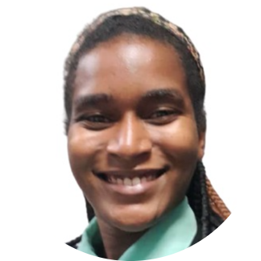
FINANCIAL INDEPENDENCE OF WOMEN
Introduction
01
02
Methodology
03
Analysis
Gothie Ridgina PASTEUR
Student at Ayiti Analytics
Memorante in Public Administration at INAGHEI
04
Conclusion

Slide 2
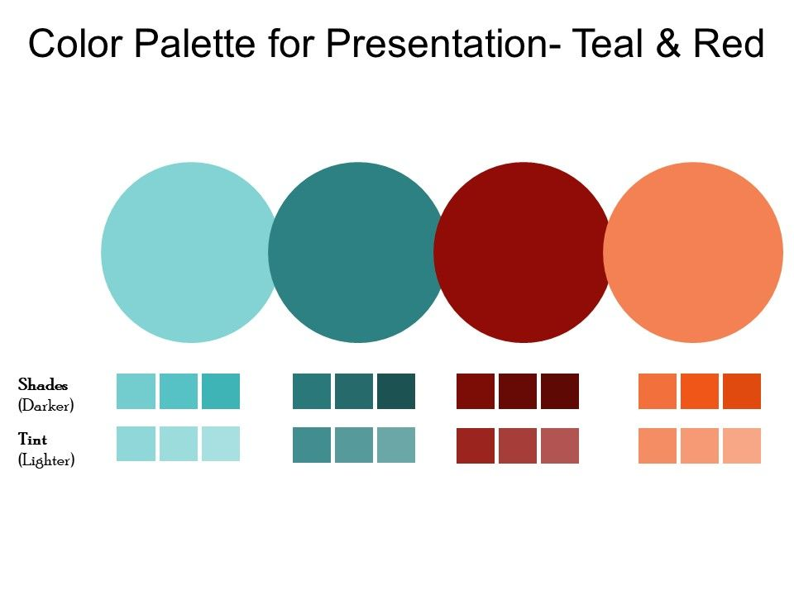
INTRODUCTION
51 %
Do you know how many of them cannot take care of their families and themselves?
1
Do you know how many of them can't live the life they want?
2
It is with all these women in financial difficulties in mind that I chose this topic. My work consists in studying the profile of independent women in order to better guide the others.
3

Slide 3
PROBLEM, AUDIENCE , DATA SOURCE
Problem
Audience
Data Source
Data are from EMMUS 2016-2017, a survey of morbidity, mortality and service utilization
The lack of financial independence of Haitian women source of lack of freedom
This work concerns women in general and all institutions that promote gender equality

Slide 4
METHODOLOGY
Data Cleaning
Data Analysis
Data collection
Target Variable Creation
Modelling

Slide 5
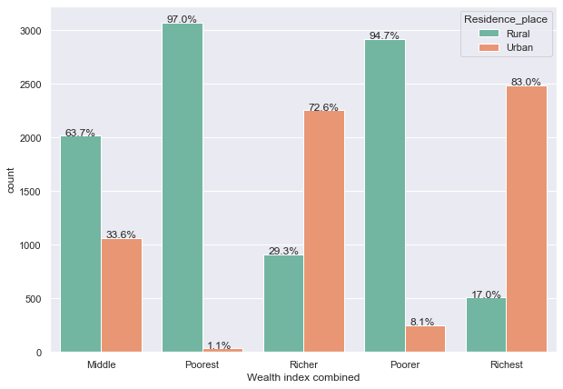
Exploratory Analysis
The majority of rich women come from urban areas (more than 50%)

Slide 6
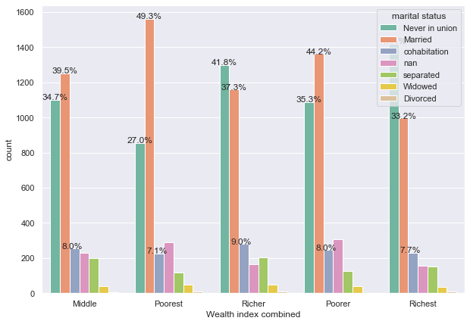
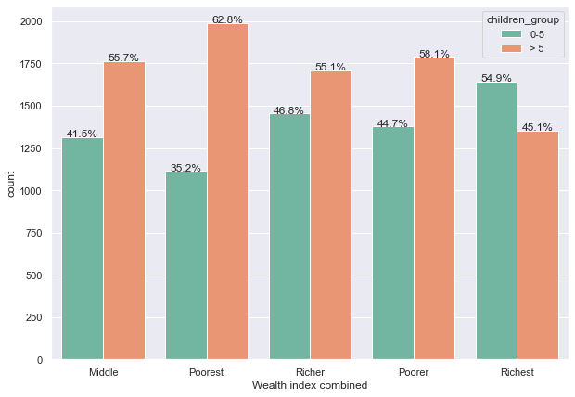
Exploratory Analysis
The women qualified as rich are not married.
Rich women have 0 to 5 children

Slide 7
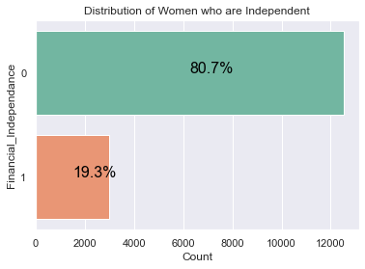
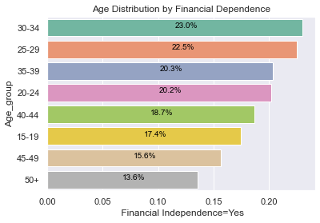
Exploratory Analysis
There are 2/10 women who are financially dependent, and this dependence starts to decrease from the age of 40

Slide 8
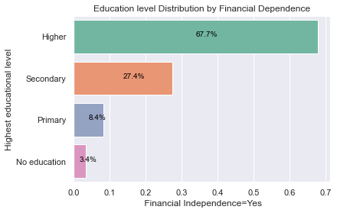
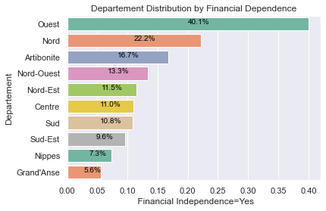
Exploratory Analysis
among these women, 4/10 come from areas with strong economic activities such as the west, the north and, out of every 10 women, at least 7 have a university level

Slide 9
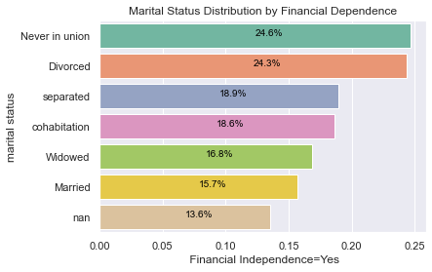
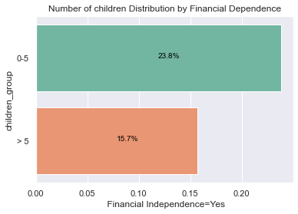
Exploratory Data Analysis
The majority of these women are not in formal relationships and they have less than 5 children. only 1/2 are married, and 3/10 have more than 5 children

Slide 10

Analytical Models
Technical document: https://github.com/gothie348/Final-project.git
Model Chosen
I used classification techniques in machine learning to predict according to the profile if the woman is financially independent or not. The chosen technique is random forest which predicts at 80% if a woman is independent or not. The variables that best predict women's financial independence are age, education level and number of children.

Slide 11



RECOMMENDATION
From the age of 40 onwards, insights show that women become less independent due to the fact that they did not save during the times when they were working hard. We recommend that financial institutions put in place policies to help women save money in their younger years.
sensitize the general population on the importance of women's financial independence for the country's economy.
Introducing women to entrepreneurship from primary grade and give them financial education.

Slide 12

CONCLUSION
Equality in Haitian society is the business of the entire Haitian population. According to the number of observations of the dataset, more than 50% of women are financially dependent and most of them are between 19 and 29 years old, which means that it is the female youth of the country who live in these conditions.
So what are you going to do?
Sit back and watch or get involved?
The choice is yours.

Slide 13

YOU CAN CONTACT ME ON
LINKEDIN: www.linkedin.com/in/gothie-ridgina-pasteur
GITHUB: gothie348 (github.com)

